Slide 1

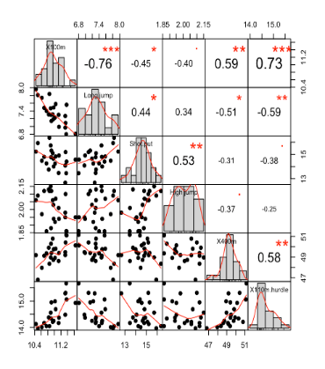
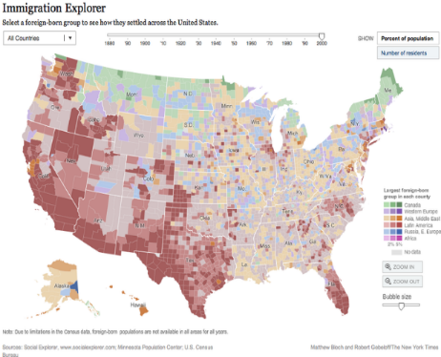
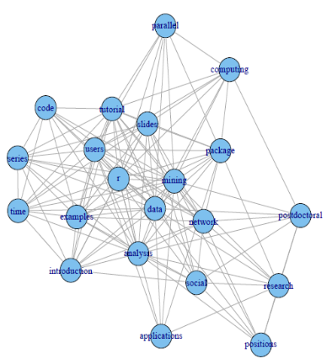
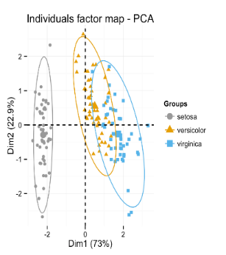
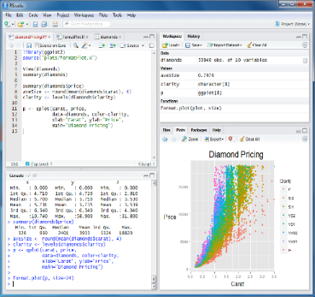
R for beginners training course Guillaume Bal & Yves Reecht https://github.com/GuillaumeBal/r.training July 2017

Slide 2
1. Coding, R and this course
This section will tell you about the aim of the course, why you should use R and the R language history

Slide 3
Coding generalities

Slide 4
Code or program
Simply a series of commands
you give to your computer
to perform a task (simple or complex)

Slide 5
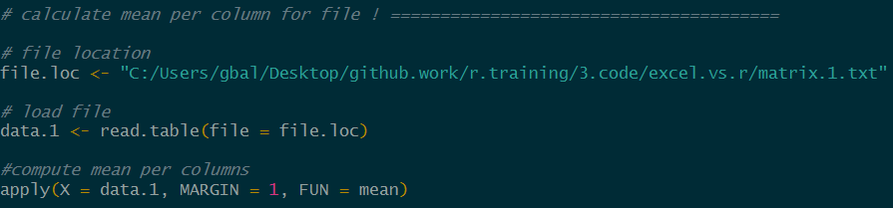
Coding (R) Vs clicking (Excel) Similarities
All steps in excel translate as command lines
Ex : calculate the mean per column from a file
Get ‘to’ file location
Open file
Compute mean

Slide 6
Coding (R) Vs clicking (Excel) Differences
For 100 files calculate the mean per column and store in new file
steps
Get ‘to’ file location
Open file
Compute mean
Include in new file
R vs Excel
Speed : R / excel = 10min / 50min = .2
Copy pasting errors : 0 with R
program reusable
program easy to share (email)

Slide 7
More reasons for coding
Easier automation
Faster computation
Easier to avoid, find and fix errors
Reproducibility (important for detecting errors)
Easier project organization
Version control possible (GIThub)
More powerful data manipulation
Advanced statistics capabilities
Loading of any type of data
Support large data sets
General
‘Data languages’

Slide 8
Coding language
Language = medium of communication / interaction
Shared ‘conventions’ to communicate
English, signs, maths… are languages
Coding language = language suitable to interact with computer
Same basics with all languages
Once you get one it is easier to get the next one

Slide 9
Coding architecture (think recipe)
1. Instruction / command: specific, individual, clear, self contained ‘task’
mix water and flour
2. Algorithm : set of instruction for a ‘bigger more complex’ task
all instructions for icing
3. Program / code : series / sequence / set of commands / instructions to compute
Full cake recipe

Slide 10
Coding basics elements
Inputs / Outputs: interaction with external entities
loading data
exporting results
Variable: place to hold data in memory with symbolic name
Function: for executing an task (think executing an action)
Conditional: execution of task if condition satisfied
Loops: repeating commands

Slide 11
R and aim of the course

Slide 12
What’s R ?
Statistical programming language
Second or open source version of S developed
In 1993
by the Bell Labs and John Chalmers
Available at https://www.r-project.org/

Slide 13



R cons & pros
Steep learning curve
Memory usage
Not always the fastest
No automatic update
Minimal GUI
A few syntactical curiosities
Does not compile
Easy to install
Supports 64 bits configurations
‘fairly easy to program’
Developed for data oriented problems
High quality analysis
Fortran, C (C++), python wrappers
Open source & cross platform
Free
Huge community (millions users)
100s of packages
Loads of resources (online, books)
Help forum, mailing lists
Developed by statisticians for statisticians

Slide 14


Aim of the course
Get you started on that journey with R
By learning
How to use the 5 basic coding elements
how to the do most common data manipulating and viewing tasks
How to do a few common analyses (bonus if time)
Then you will be able to keep going on your own

Slide 15
Beginning tips

Slide 16





Graphical User Interfaces
GUI makes R more user friendly you more productive
GUI are IDE (Integrated Development Environment), i.e. have tools to speed up development
text editor (syntax highlighter, parenthesis checking …),
R command line completion
Data visualization tools …
Most of them are free
NppToR in Notepad++
Tinn-R
JGR
Emacs (for programming freaks)
Rstudio

Slide 17
Started in 2011
Why chose RStudio ?
Graphical workspace
cross-platform interface
tab-completion of filenames, function names and arguments
seamless Rmarkdown and knitr integration for reports
Integrates Shiny for online reports
User friendly, clear, loads of options, cross language…
Updated regularly

Slide 18
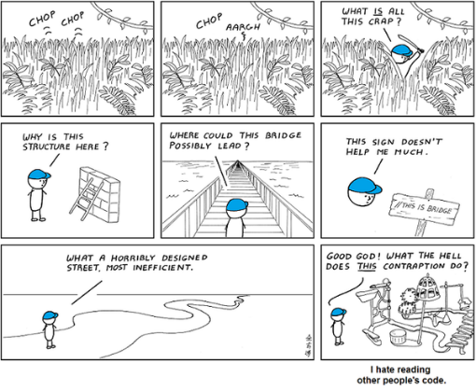
Good coding practices
Use one instruction per line
Use meaningful names
Comment our code
Use # in front of comments
Be descriptive
Indent it too !
(Ctrl + I in RStudio)

Slide 19
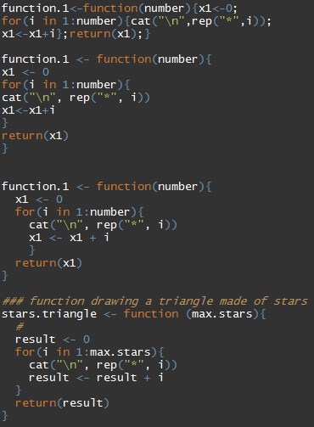
Good coding practices

Slide 20
Install links
https://cran.r-project.org/bin/
https://www.rstudio.com/products/rstudio/download/
https://github.com/GuillaumeBal/r.training

Slide 21
2. R language basic structure
This section will tell you about the basic elements the R language relies upon

Slide 22
2.1 Concepts and conventions

Slide 23
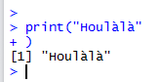
Console VS script
Console (the unfriendly stuff which appears when you open R)
Prompt: console available
“Waiting” prompt: incomplete command (closing bracket missing)
Script
A text file (usually *.R) containing a series of instructions (R code, ~computer program):
Loading data
Cleaning/manipulating data
Analyse of data
Export of results
…

Slide 24
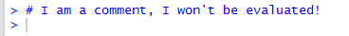
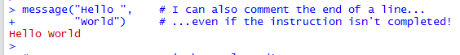
Comments (to be used extensively in scripts)

Slide 25
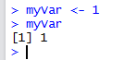
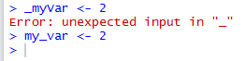
Variable declaration/assignment
Assignment with “ <- ” or “ = “:
Names: letter or “.” followed by letters, digits, “.” and/or “_”
Case sensitive myvar ≠ myVar
Avoid all other characters ($%&{[]}@+*\/…): special meanings.

Slide 26
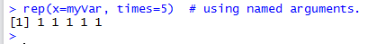
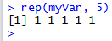
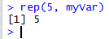
Functions
A function fulfil a task (return a value, print, plot, …)
<function_name>(<arg_name1> = <argument1> , <arg_name2> = <argument2> , ...)
Information on a function?
Argument names can be ignored… with caution!
Named arguments
≠

Slide 27
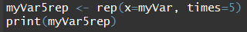
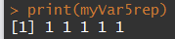
Functions
The result of a function returning a value can be stored in a symbolic variable:
the result of a function can be used as an argument of the following function (“chaining functions”)

Slide 28
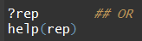
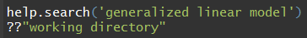
Built in help
If you want help on a specific function, e.g. plot()
If you want to search by keyword in all the functions documentations
Anything more user friendly? HTML browser, with a search tool:
Parameters
Returned value
Examples
…

Slide 29
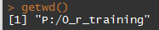
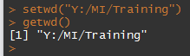
Working directory
…where R will look for file, save them, etc.
Query with getwd()
Set with setwd("<path>")
double the \ (windows only) or
use / …for compatibility.

Slide 30

Exercises
Create an Exercice_2.R script (see the “File” menu). From now on you will do the exercises in this file and send the code in the console).
Change your working directory to where you saved it.
Create a variable “rep53” containing 3 times the value 5.
print it (congratulation, this is your first use of the result of a function in another function :).
Create a variable “nRep” containing the number of elements in rep53… Assume you don’t know it! Tip: ?length

Slide 31
2.2 Vectors data types, structure and manipulation

Slide 32
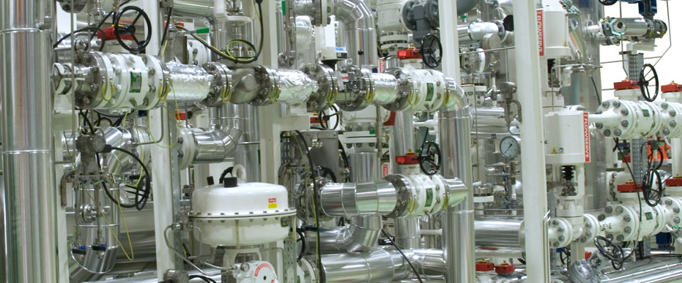

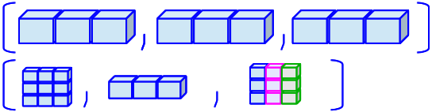
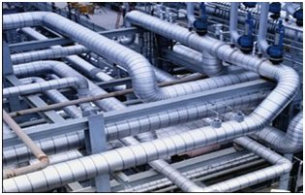
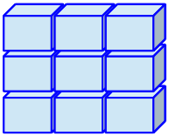
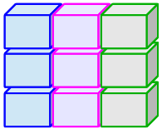
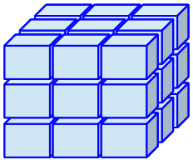
Overview of mains structures in R
# dimensions | Type of data
 | Homogeneous | Heterogeneous
1 | vector | List
2 | matrix | data.frame (tables)
N | array
Data type

Slide 33
2.2.1 Types (modes) of data
Functions mode(), typeof()
Main modes:
numeric: 1, 3.14,… NaN (Not a Number; e.g. 0 / 0) -Inf, Inf (∞) …is the mode reported for types integer and double.
character: "Hello world", 'c\'est la vie',…
logical: TRUE, FALSE
complex: 1 + 2i,…
NA : Not Available (any type).
NULL: ~ empty (e.g. declaration of an empty variable)

Slide 34
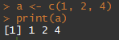
2.2.2 Vector structure
Set of unitary elements of homogeneous type.
The vector is the base structure in R. Even a variable with one element is a vector… notice the [1] (pos. of 1st element on the line)
Every type of data has its own function to create a vector of a given length:
double(<length>), integer(…), numeric(…)
character(<length>)
…
Function concatenate c(…)
length

Slide 35
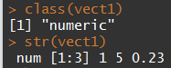
2.2.2 Vector structure (Class)
Function: class(), str()
Note that on a vector, the function class() return the mode!
Other vector-like structures exist…

Slide 36
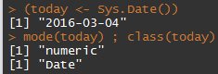
2.2.3 Vector-like structure (class)
factor: a integer vector with a “levels” (names) attribute! extensively used but very confusing (behave either as a numeric or a character… depending on the context)! !!! Plenty of implicit conversions in R
Two more classes that behave like vectors (numeric vectors + attributes to be interpreted as temporal information)
Date:
POSIXct/POSIXlt: date-time.

Slide 37
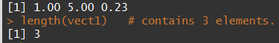
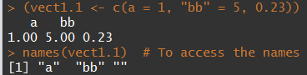
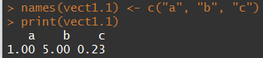
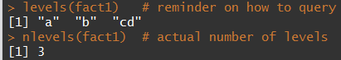
2.2.4 Vectors’ characteristics
How many elements? length()
Names of elements? names()
Levels (factor)? levels(), nlevels()

Slide 38
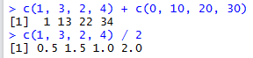
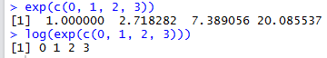
2.2.5 Vectors’ arithmetic
Basic arithmetic operators and functions:
Fully vectorised: allows avoiding most of loops
Operators: + - / * ^
Arithmetic functions: exp(), log(), log10(), sqrt(), abs(), …

Slide 39
Exercises
Create a vector ‘a’ containing the values 10, 5, 4.1 and 100. (function c)
Which is its class? Its mode?
Calculate its log in base 10 (use the help if needed).
Use ‘a’ to create a matrix ‘b’ with two columns.
… print the number of rows of ‘b’.
Create a vector of two elements with today and yesterday date (use Sys.Date)

Slide 40
2.2.6 Comparisons and tests
operators (guess what… vectorised!)
== (equal): anything that can be compared, character strings, logical, integers, doubles (!!! machine precision).
!= (not equal): anything that can be compared as well.
<, <=, >, >= : numeric, date-time.
Testing for indefinite values:
is.na(), is.null(), is.nan(), is.finite()
sets
is.element(<elements>, <set>) identical to <elements> %in% <set>
which(), match(),
See also ?union

Slide 41
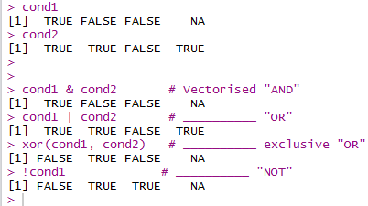
2.2.7 Logical operators
Fully vectorised… as usual & (AND), | (OR), xor (excl. OR) and ! (NOT)
Among elements of a vector:
any() at least one of the elements is TRUE
all() the elements are TRUE

Slide 42
2.2.7 Logical operators
Not vectorised
||, && and isTRUE()
Mainly used for programming control-flow (if clauses in particular). See examples.
isTRUE() returns TRUE if the condition is true, FALSE in all other cases… …regardless it is NA or any other indefinite value.

Slide 43
Exercises
Create a random vector “x” of length 10, with values comprised between 0 and 10 (function runif(…), use the help).
Which elements of this vector are greater than 5?
Test if sqrt(x)^2 equals x in all cases.
Can you show that sqrt(x)^2 equals x ± the machine precision (use sqrt(.Machine$double.eps) as precision)?

Slide 44
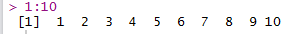
2.2.8 Sequences / repetitions
Very useful for optimising the use of vectorisation.
seq(…)
works with any combination of (arguments): from=, to=, by= (increment), length.out=, along.with= (vector of same length).
all argument defaults at 1.
shortcuts:
(from)“:” (to)
seq_len(<length>), seq_along(<vector>)

Slide 45
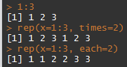
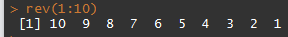
2.2.8 Sequences / repetitions
rep(…): repetition of patterns, sequences,…
rev(…): reverse a vector

Slide 46
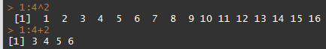
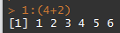
2.2.9 Operators’ precedence
R complies with the usual precedence rules (* / over + -,…)
Some tricky operators (e.g. : )
=> Always use (…) when you have a doubt

Slide 47
Exercises
Create a sequence (function seq)
from 2,
with the length of the vector x (from exercises section 2.2.7 – assume you don’t know its actual length)
with an increment of 1
in two different ways … of which one using “:”!
Create the same sequence using seq_along().
Reverse x and store it in x2.
Create a sequence from 100 to 0 by an increment of 5

Slide 48
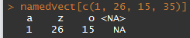
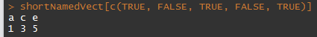
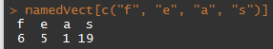
2.2.10 Indexing vector data
How to access/extract a subset of a vector?
several ways, operator […]
position
logical indexation
by name

Slide 49
2.2.10 Indexing vector data
Everything but…
use negative position indices:
=> Elements 1 and 26 suppressed from the output

Slide 50
2.2.11 modification of a subset
How to replace a subset of a vector?
Modify as you access!
several ways, operator […]
position
logical indexation (test)
by name

Slide 51
Exercises
Create a vector “seq5” as a sequence from 1 to 5
Name the elements as the first five letters (from the vector letters). (decompose… first extract the letters,…)
Select the elements 2 and 4 using two different ways. Which are greater than 3?
Run size <- rnorm(n = 10, mean = 30, sd = 3) Which “individuals” have a size of at least 33? How many are they?

Slide 52
2.3 Further data structures

Slide 53
2.3.1 Data types and structure
# dimensions | Type of data
 | Homogeneous | Heterogeneous
1 | vector | List
2 | matrix | data.frame (tables)
N | array

Slide 54
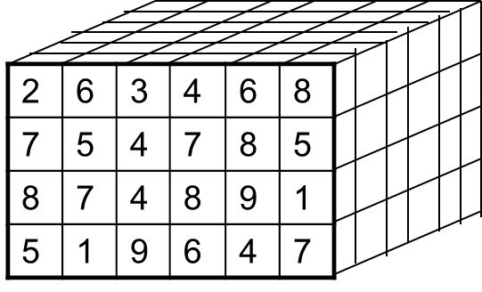
Main classes
matrix: any mode suitable for a vector + 2 dimensions.
dimensions can be named
matrix algebra fully supported in R.
created by matrix(…), cbind(…), rbind(…)
array: ~ same as matrix but not limited in dimensions.
Rows
Columns

Slide 55
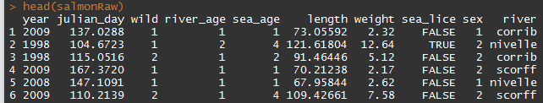
Main classes (continued)
list: catchall structure.
Each element can be of any class or NULL.
The elements can be named.
data.frame: table with different types of data
a type of list (all elements have the same length) 1 column ≈ 1 vector.
two dimensions (rows x cols).
extensively used for ecological data.
!!! characters systematically converted in factors by default!
Rows
Columns

Slide 56
2.3.2 Matrices’ algebra
R is well suited for matrix computations.
Several dedicated operators and functions … see examples

Slide 57
2.3.3 Accessing some attributes
 | 1 dimension (vector, list,…) | 2 dimensions (matrix, data.frame,…)
Number of elements | length(x) | dim(x)* (both dim at the same time) nrow(x) ncol(x)
Names of elements | names(x) | dimnames(x)*(both dim at the same time) colnames(x) row.names(x)
Levels (factors) | levels(x) nlevels(x)
* Can be also used with >2 dimensions.

Slide 58
3. Data manipulation
This section will give you the basics for manipulating data in R

Slide 59









Data loading
In a nutshell you can load everything you want !
Flat files (simple text files) : read.table() & read.csv() functions
Excel files : packages openxlsx, readxl, gdata, XLConnect, xlsx
https://www.datacamp.com/community/tutorials/r-tutorial-read-excel-into-r?tap_a=5644-dce66f&tap_s=10907-287229
Other statistical softwares: packages haven or foreign (+ Systat and Weka)
Relational data base : package RMySQL, RpostgreSQL, Roracle, DBI
Data from the web : package TwittR2Mongo
(Packages are collections of functions)

Slide 60
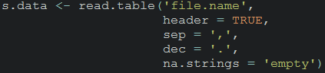
Data loading, read.table()
to read flat file (.txt and .csv)
Import them as data.frame
Quite a lot of arguments (?read.table)
File name, can include location, even online adress
Is the first line of your table variables names ?
Field separator character
Decimal separator character
a character vector of strings which are to be interpreted as NA

Slide 61
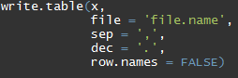
Data saving, write.table()
to save your data, quite similar to read.table()
outputs are .txt or .csv. files
Quite a lot of arguments (?write.table)
x, the data you want to save
file name, can include location
field separator character
decimal separator character
row names specification

Slide 62

Data loading and saving, excel files
For .csv files see
‘read.table’ and ‘write.table’
‘read.csv’ and ‘write.csv’

Slide 63


File location
R does not support \ in addresses
Instead use ‘\\’ or ‘/’
Recommended

Slide 64


Course dataset
Salmons caught in traps (see code)
5 rivers (3 Irish & 2 French)
covers 1995-2015 period
Includes for each fish
river of capture
date
marine and river age
length and weight
infection by sea lice
Some scatterbrained people including one english

Slide 65
Exercises
Import the salmon.raw.data.txt file in R
as a data.frame called ‘salmon.raw’ (use setwd() and read.table())
Display a few rows to check everything is alright (head())
Look at the dimension of the dataframe
Save the data in your folder as ‘salmonRawYourName.txt’
(write.table())

Slide 66
3.3 Indexing data
Access and modification of particular elements in matrices, data.frames,…

Slide 67
Indexing vector data – Reminder
How to access/extract a subset of a variable?
several ways, operator […]
position
logical indexation
by name

Slide 68




Indexing data with several dimensions
operators […]as well
dimensions separated by “,”
order: rows, columns,…

Slide 69



Indexing data, matrices
Different methods can be combined
R usually tries to simplify by default:
Problem: when programming you not necessarily know a priori the # row or col selected and the behaviour changes if only one. => option drop = FALSE.

Slide 70
Indexing data, lists
Extracting one element
with the position: [[<i>]]
with its name: [["<element_name>"]] or $<element_name>
range of element (!!! returns a list): […] Works just as for a vector: by position, name, logical indexation.

Slide 71


Indexing data, data.frames
data.frames: lists in which every element is a column… + 2 (possibly named) dimensions
2 things to remember
column = vector Dimensions are used just as for matrices:

Slide 72




Modifying data
General rule: “you modify as you access”:
<object>[…] / $… / [[…]] <- value
Also works sometimes for adding/removing stuff:
Adding columns to a data.frame Removing a column

Slide 73


Modifying data
Further remark: the “change as you access” rule also extends to most of other functions accessing attributes of the objects ([row.|col]names(), levels(),…): … and can even be combined with indices:

Slide 74



3.4 Subsetting data
Using a test
removing elements by position:
subset(x, <condition>) function:

Slide 75
Exercises
Using the salmon data:
Create a new data.frame “salmonSub10” with the 10 first rows of salmonRaw.
Remove the column “wild” from salmonSub10.
Select the individuals in salmonSub10 with a length greater or equal to 80cm. Hint: Examples ## 3.4 Cleaning/Subsetting data

Slide 76


3.5 Data types conversion
Including classes that behave like vectors.
Functions as.<type>(…) usable from different compatible types:
Mind the factor’s split personality!

Slide 77

3.5 Data types conversion
Text formatting: for numeric, Dates, POSIXct,… you may want further control => format(…)

Slide 78

3.6 Ordering data
sort() -> order a vector.
order() -> indices to order data (possibly >1 factor)

Slide 79
Exercises
Using the salmonRaw data
What is the class of the column “river”? (how do you extract a column? Hint: $)
List the different rivers in the dataset (clue in 2.2.4, 2.3.3).
Create a “new” data.frame (named salmonSub) with only individuals from the rivers Corrib and Scorff
Order it by river and year.
How many rows does it contain?
Save it to a file “salmonSub.csv” (comma separated)

Slide 80
4. Data mining, basics
This section will give you the basics for simple data mining in R

Slide 81
4.1 basic statistics & data visualisation

Slide 82


4.1.1 Data preview
Because datasets often very large
<object>[…]
head(<object>, n = <nb_elements/rows>)
tail(<object>, n = <nb_elements/rows>)

Slide 83


4.1.2 Data types and summary
Data types/structures
summary(…)
vectors
data.frame

Slide 84


4.1.3 Basic statistics
mean(…), median(…), min/max(…), sum(…), sd(…), var(…),…
!!! NA sensitive: use na.rm = TRUE (if any):
Note on logicals: behave as 0/1 => convenient for summarising tests!

Slide 85

4.1.3 Basic statistics, quantile()
default: quartiles
quantiles can be changed with probs = …

Slide 86

4.1.4 Contingency table, table()

Slide 87
Exercises
Store salmonRaw in a new “salmonTidy” data.frame. You will now work on this data set.
Detect incorrect weights and correct them.
Remove entries with impossible dates (ignore leap years).
Recode the column “wild” (1 -> TRUE, 2 -> FALSE)
Save it in a salmonTidy.csv file

Slide 88




5. Graphics
This section will tell you about the basic elements the R language relies upon

Slide 89
Basic graphics
plot(), hist(), boxplot(), barplot(), pairs(), matplot()

Slide 90


plot()
Most basic graphic, displays Y Vs X
See ?plot for more customisation

Slide 91


hist()
Displays histogram
=Graphical representation of the distribution of numerical data
break = argument controling number bars

Slide 92


barplot()
Displays rectangular bars with lengths proportional to the values that they represent
Works on
vectors (regular barplot)
matrices (including contengency tables, stacked barplots)
Legend later

Slide 93


boxplot()
Displays groups of numerical data through their quartiles
You can display a box for different factor levels

Slide 94

matplot()
To display simultaneously multiple
time series
Relationships (mean weight / mean length per river)

Slide 95


pairs()
Displays relationships between all variables of dataframe

Slide 96

Saving graphics
R graphics can be saved as
.pdf files , pdf() function
.tiff files , tiff() function
.png files, png() function
...
Generic way it works
pdf() / tiff() … # ‘start recording’ instruction using
plot() / boxplot() … # all plots you want
dev.off() #‘closure’ instructions using
Arguments needed quite similar for all the kind of outputs

Slide 97
Exercises
Plot length Vs weight of sea.age = 1 fish from Moy river
Histogram weight of fish from Ireland
Boxplot of weight with a box per year
Save some of your graphics
Barplot number of fish per year (contengency table)
Matplot number fish per river per year (if time)

Slide 98
Customizing graphics
Lines, points, axes and text styles
Plotting area, par()

Slide 99


Features type
With type argument plot function

Slide 100



Points, lines and colours
Points type : pch =
Color : col =

Slide 101
More features
You can insert legends with legend()
Add text to the plot using
text()
mtext()
Create custom axes
Set axes = FALSE in plot() or boxplot() or ...
Draw your custom axes using axis()
Add curves, lines, other points
lines()
abline()
Curve
points()
Find the coordinates of points using locator()

Slide 102


More features

Slide 103
Exercises
Plot the length Vs weight of
all fish with a different color per river (see col argument, use river data as numeric)
fish from the Moy river with small points, limit weight axis to 10 (see pch and ylim arguments)
Show us your artsy side, play with the arguments

Slide 104

par(), global parameters
Queries graphical parameters
Sets parameters for all subsequent graphics
Split your graph window
multiple graphs per window with mfcol or mfrow
control inner and outer margins mar() and oma()
JUST 4 values within oma() and mar() !!!!

Slide 105

par()
http://rgraphics.limnology.wisc.edu/rmargins_sf.php

Slide 106
Exercises
use x11() to create new graph windows
Use argument mfrow of par() to allow for 3 graphics
Use arguments oma of par() to make really small outer margins
Add the 3 graphics on the figure panel (your choice)
Save that panel as a .pdf file

Slide 107

ggplot2 package
A package for graphics

Slide 108
ggplot2 package
A package dedicated to graphs
Based on the grammar of graphic approach relying on
Aesthetics, ie what you plot
Geometries, ie how you plot it (points, lines, ribbon…)
According to some people
More intuitive ?
better that basic R graphic functions because you need less code

Slide 109




ggplot2 package, examples

Slide 110


ggplot2 package, examples

Slide 111




ggplot2 package, examples

Slide 112

More on graphics
ggplot
Sarah BIGFish talk documents https://bigfish.joomla.com/meetings
http://www.cookbook-r.com/Graphs/Axes_(ggplot2)/
maps : see Hans course https://bigfish.joomla.com/meetings
http://girke.bioinformatics.ucr.edu/GEN242/vignettes/15_Rgraphics/Rgraphics.html
http://www.r-graph-gallery.com/

Slide 113

6. Repetitive & conditional tasks
How to avoid loops, well because they are
- slow (not always the case)
- because they are more complicated to write
How to make loops when you have no choice

Slide 114
6.1 Applying the same function - over one dimension of a matrix/dataframe/array, apply() - by factor levels on a vector, matric, dataframe,by() - over elements of a list, sapply() and lapply()

Slide 115

Apply across dimensions : apply()
To perform an operation by rows or columns of matrix/dataframe/array
For instance to get quantiles by rows
x, the data you want to use
1 for rows and 2 for columns
The function you want to use
Argument linked to quantile()

Slide 116

Apply functions by factors or combinations of factors
by(), for vector, dataframe and matrix, list output
tapply(), for vector only, matrix output

Slide 117


Apply functions on elements of list
lapply()
returns a list of the same length as X
each element is the result of applying FUN
sapply()
a user friendly version of lapply(), FUN instead of MARGIN
returns a vector or matrix

Slide 118

Including functions’ arguments
For all of previous functions (apply, by()…)
When specifying FUN / MAGIN, you my need to include arugments
You add that argument within apply… function
Example, for dealing with NA

Slide 119
Exercises
Subset salmon data for columns year, weight, length & julian.day and store as salmon.num
Use apply() to calculate the mean of the columns
Use apply to compute quantiles 0.2, 0.4, 0.6, 0.8
Calculate mean size of fish by (use full dataset)
year
year and sea age

Slide 120
6.2 loops - for() loop, performs instruction for given number time - nesting loops - if(), for conditional tasks, not a loop but part of nested loops - while() loop, perform instructions while condition is satisfied

Slide 121





for() loops
repeat action for a determined number of iterations
‘i in 1:n’, i is called a counter, it follows a sequence
When to use them ?
You have to repeat an operation several times (> 3 - 5)
You can’t use vectorization or use apply() and the likes

Slide 122

Nesting loops
You can nest as many loops as you need

Slide 123


Conditional tasks with if()
Is used to executed a task based on a condition
Is generally within a for loop
Specific options, CAREFULL ABOUT THOSE
break() to get out of loop if condition not satisfied
next allows to go to the next iteration

Slide 124


while() loop
To repeat an action until condition satisfied

Slide 125
Exercises
Create a for loop saving each year of the salmon data into a different ‘.txt’ file (use paste())
get a vector of unique values of years
Create subset
Create file name using paste
Do your loop
Create a for loop making a pdf containing an histogram of each column of the salmon data
being of class numeric (nested if)
add the corresponding column name as title for each graph

Slide 126


7. More advanced analyses & programming
This section will tell you about
1. creating functions
2. basic analyses of data
3. Reproducibility
Linear models
Y = a + bX + e, e iid

Slide 127

Functions
function = part of a computer program that performs some specific action
You can create your own ones !
They return one thing only (but this can be a list)

Slide 128

R function writing example
Guess what it does !

Slide 129

R functions, get details
A function has three attributes

Slide 130
Exercises
Create a function
making the sum of 2 integers
including an error message if arguments aren’t integers
Create a function
checking whether a single number is in a vector
giving you an error message if arguments are not a number and a vector

Slide 131
Non parametric smoothing
Used to highlight trends in the data
lowess()
is one function performing smoothing
argument ‘f’ modify the degree of smoothing
For more details and functions see Hans talk at https://bigfish.joomla.com/

Slide 132


lowess() examples

Slide 133
Correlations / linear models
bartlet.test(), test homoscedasticity or homogeneity of variances, one of the main hypothesis
cor.test() , correlation between 2 variables
anova(), comparison of means
lm(), glm() allow for linear regression

Slide 134


cor.test() and lm() example

Slide 135
Generalized Additive Models
Are linear models and smoothers mixed
Model selection need to be performed
MGCV package advised
Hans talk https://bigfish.joomla.com/

Slide 136
Generalized Additive Models
NOT PUBLIC
Window configured with layout()

Slide 137
General-purpose optimization in R
Recommend optmix package
Fits model by
minimising residual sum of squares
minimising deviance (requires writing likelihood)
See code for details (7.4.optimx.r)
Window configured with layout()

Slide 138
8. More always more
This section will tell you about
1. potentially usefull packages
2. where to learn more

Slide 139
Reports, R markdown package
It is
Package developed by r studio based on knitr and pandoc
Fully integrated in r studio
Useful for
Easily creating dynamic documents
Web pages
Reproducible analysis and reports
Data work up for WGs – html/word
Working Group reports - word
Survey reports – word/pdf
Documenting packages/functions – pdf
See Colm talk at https://bigfish.joomla.com/

Slide 140
R packages
Data manipulation / cleaning
tydr (no obvious advantage)
stringr for string manipulations
dplyr (uses intuitive syntax)
data.table (syntax ‘close’ to SQL, time efficient on big tables)
lubridate (to mess with date formats)
zoo, xts and quantmod (for time series)
Plots
ggplot, ggplot2 (plotting package based on grammar of graphic)
ggvis (interactive web graphic)
Ploty (interactive, browser-based charting library )
Mapping
See Hans talk on https://bigfish.joomla.com/
Reporting
R markdown in Rstudio, see Colm talk on https://bigfish.joomla.com/
Function Sweave to generate LATEX documents and pdf
Package OdfWeave for open office documents
Web application
Shiny

Slide 141
R packages, fisheries
FSA : Fisheries Stock Assessment
FLR : Fisheries Library in R
fishmethods : Fisheries Methods and Models in R
fishdynr : Fisheries Science Related Population Dynamics models
TropFishR : Tropical Fisheries in R …
More on R for fisheries analyses website
http://derekogle.com/fishR/

Slide 142


Write your own models
Optimizers (see before)
nls()
nlminb()
optim()
package optmix include all previous (see code)
Call specialized software using R packages

Slide 143






More help
Books
Forums
http://stats.stackexchange.com/questions/tagged/r
http://r.789695.n4.nabble.com/
Mailing list
R help mailing list, https://stat.ethz.ch/mailman/listinfo/r-help
BIGFish mailing list, bigfish_mailing_list@googlegroups.com
Google
loads of documents
choose you keywords wisely
you’ll probably end up on one of the forums mentioned

Slide 144


Slide 145
More exercises
loops
plot length/weight
by river for every year, all rivers for one year on same panel
save into a pdf

